Slide 1



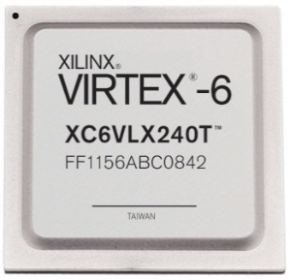
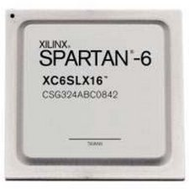
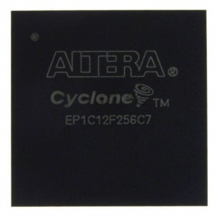
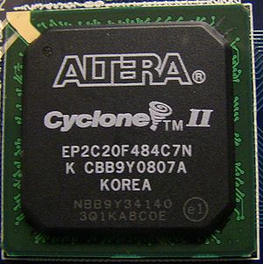
EEE4084F
Digital Systems
Lecture 16
RC Architecture Types &
FPGA Interns
Lecturer:
Simon Winberg

Slide 2
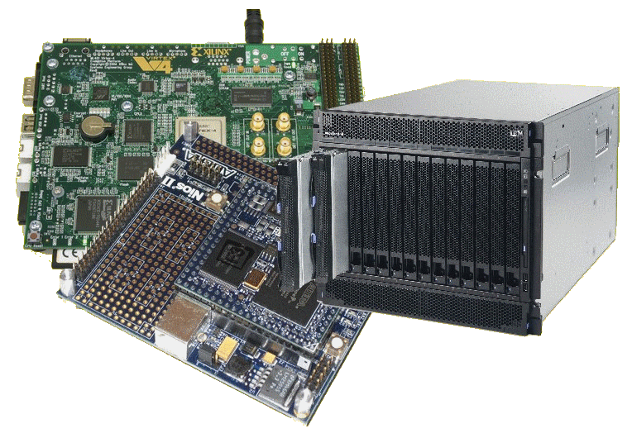
Lecture Overview
Reminders & YODA milestone dates
Marking process
RC Architecture overview & main types
Recap of FPGAs

Slide 3

Reminder
Form YODA project groups!!
Indicate your team in the Wiki. Add a blog entry to describe your topic
Start on your project ASAP
7 May – Design Review

Slide 4
Project Teams & Marking
Projects done as teams of 2 or 3
  (confirm team of 1 or 3 with lecturer)
Milestone Dates
  Blog (due 3 Apr)
  Design review (todo list by 7 May)
  Demo (16-17 May)
  Code and final report (20 May)

Slide 5

Early Notice:
Quiz 3 Thursday (25 Apr)
Held 2pm, 45 minutes
Covers
  Lecture 12 – 16
  Seminar 7 (CH7),
  Seminar 8 (CH14)
Quiz next
Thursday!

Slide 6
Report Marking process
Assignment work is marked in relation to
  Correctness
  Completion
  Structure, effectiveness of wording & layout
  Adequate amount of detail/results shown & effectively dealing with the details
  Indication of student’s understanding and engagement with the discipline
  Clarity of explanations/motivation of results
  Professionalism and overall quality

Slide 7
Structure & Effectiveness
Note that a mark out of 10 is just an example, depending what the assignment is marked out of in total, and weighting for different sections, this can change
0 lower marks
10 higher marks
Cobbled together;
List of points with no effort to formulate a logical structure or flow to the argument/results
Well structured;
Clear progression;
Logically structured;
Clear and effective use of headings (if headings are requested); table of contents and clear title (if asked for)

Slide 8
Understanding
0 lower marks
10 higher marks
Poor understanding;
Over generalizing;
Mathematical/logical mistakes;
Non-critical discussion;
Stating facts without adequate
motivation
Clear grasp of methods;
Good discussion of techniques;
Correct math and calculations;
Good choices;
Indication of scope;
Clear / logical reasoning
and motivation;
Appropriate terminology

Slide 9
Correctness
0 lower marks
10 higher marks
Wrong answers;
Many mistakes;
Illogical results; Inadequate proof / evidence for presented conclusions or results.
Correct answers;
Well formulated proofs /
correct explanations;
Logical deductions used;
Adequate evidence / proofs to support conclusions or generalized results

Slide 10
Level of detail & Dealing with details
0 lower marks
10 higher marks
Too little detail … or perhaps an excessive amount that makes it difficult to make sense (for the maker) of what is being shown
An effective amount of detail. Using means, such as annotations and textual explanations, to bring out important results if a lot of data was given in the report.

Slide 11
Engagement with the discipline
0 lower marks
10 higher marks
Using ineffective terminology. Ineffective techniques, e.g. inappropriate for the work concerned. Cumbersome explanations not building on well understand theories in the discipline.
Effective use of discipline-specific terminology; effective use of techniques and knowledge that are well understood in the discipline. Elegant explanations using references were applicable.

Slide 12
Professionalism
0 lower marks
10 higher marks
Poor layout of documents;
Inappropriate wording;
Poor choice of fonts;
Confusing discussions and explanations;
Errors in symbols and units;
Grammar and spelling mistakes;
Inconsistencies
Elegant and easy-to-read layout;
Good wording, well organized;
Clear discussions and
explanations;
Proof-read;
Good references (if needed);
Cross-referencing to other parts of the document (if relevant);
Consistent;
Good grammar and correct spelling.

Slide 13
RC Architectures Overview
Reconfigurable Computing

Slide 14
Is it or isn’t it reconfigurable…?
A determining factor is ability to change hardware datapaths and control flows by software control
This change could be either a post-process / compile time or dynamically during runtime (doesn’t have to be both)
While the trivial case (a computer with one changeable datapath could be argued as being reconfigurable) it is usually assumed the computer system concerned has many changeable datapaths.
processing
elements
Datapath

Slide 15
RC Architectures
Currently there are two basic forms:
  Microprocessor-based RC
  FPGA-based RC
    Microprocessor-based RC:
    A few platform configurability features added to a microprocessor system (e.g., a multi-processor motherboard that can reroute the hardware links between processors)
    Besides that we’ve already seen it all in the microprocessor parallelism in part of the course

Slide 16

RC Architectures
– basic forms
Microprocessor based RC
  Multi-core processors dynamically
  joined to create a larger/smaller
  parallel system when needed
  Assumed to be a single computer
  platform as apposed to a cluster of computers
  Needs to support software-controlled dynamic reconfiguration (see previous slide)
  Tends to become:
  Hardware essentially changeable in big blocks
    (“macro-level reconfiguration” - whole processors at a time)

Slide 17

RC Architectures
– basic forms
FPGA based
  Generally much smaller level of
  interconnects (more at the “micro-level reconfiguration”)
  Processors that connect to FPGA(s)

Slide 18
General Architecture for using FPGA-based RC
Generally, these systems follow a processors + coprocessors arrangement
  CPU connectors to reprogrammable
  hardware (usually FPGAs)
  The CPU itself may be
  entirely in an FPGA
The lower-level
architecture is more
involved… topic of Seminar #7 (‘Interconnection Fabrics’) and further discussed in later lectures.
Multi-processor or multi-core processor computer
CPU
CPU
…
high-speed bus
FPGA-based Accelerator card
FPGA-based Accelerator card
…
Plug-in cards

Slide 19

FPGA Interns
EEE4084F

Slide 20
FPGA internal structure
Programmable logic element (PLE)
(or FPLE*)
Image adapted from Maxfield (2004)
Note: one programmable logic block (PLB) may contain a complex arrangement of programmable logic elements (PLE).
The size of a FPGA or programmable logic device (PLD) is measured in the number of LEs (i.e., Logic Elements) that it has.
* FPLE = Field Programmable Logic Element

Slide 21
Logic Elements
– Remember your logic primitives
You already know all your logic primitives…
  The primitive logic gates
    AND, OR, NOR, NOT, NOR, NAND, XOR
    AND3, OR4, etc (for multiple inputs).
  Pins / sources / terminators
    Ground, VCC
    Input, output
  Storage elements
    JK Flip Flops
    Latches
  Others items: delay, mux
OR
Input Pin
Output Pin
Altera Quartus II representations

Slide 22
Look Up Tables (LUTs)
The usual strategy for implementing PLBs
A simple but powerful approach to FPGA design is to use lookup tables for the PLBs. These are usually implemented as a combination of a multiplexer and memory (even just using NOR gates)
Essentially, this approach is building complex circuits using truth tables (where each LUT enumerates a truth table)
examples follows…

Slide 23
Simple 3-LUT implementation for a PLB
input values
000
0
001
1
010
1
011
0
1-bit output
100
1
101
0
Any guesses as to what logic circuit this LUT implements?
110
0
111
1
8-bit static memory
3
3-bit input bus

Slide 24

Simple 3-LUT implementation for a PLB
It’s an XOR of the 3 input lines!!!
input lines
in out
output
000
0
001
1
010
1
011
0
100
1
101
0
110
0
111
1

Slide 25
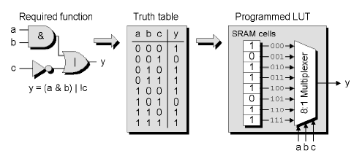
Mainstream* Programmable Logic Block (PLB)
Configure synchronous or asynchronous response (i.e. a line from another big LUT).
config_sync
k-input LUT
0
k inputs
output
…
DFF
1
clock
Another example for implementing an alternate logic function.
Image adapted from Maxfield (2004)
* Used by manufacturers like Xilinx

Slide 26
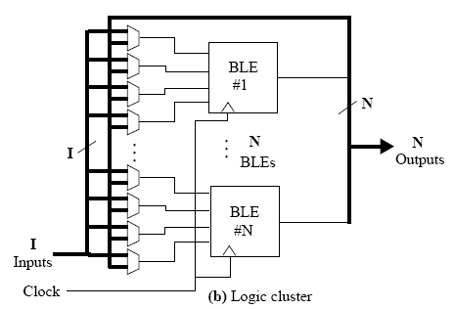
Logic block clusters (LBCs) and Configurable logic blocks (CLBs)
Assume a k-input LUT for each logic block (LB)
Assume N x LBs per logic cluster
BLEs in each logic clusters are fully connected or mostly connected
The diagram shows the same input lines (I) are sent to each LB, in addition to each of the N LBs’ output lines. Each LB operates on 4 input lines at a time, and a MUX is used to decide which input to sample. The MUXs may be configured from a separate LUT, or could be controlled by the LB it is connected to.
LB
…
N x LBs
LB
Diagram adapted from Sherief Reda (2007), EN2911X Lecture 2 Fall07, Brown University

Slide 27
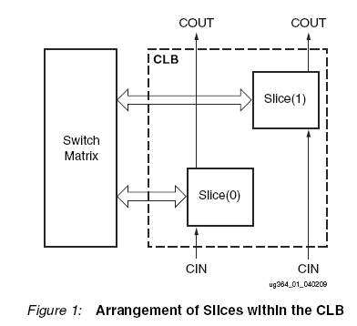
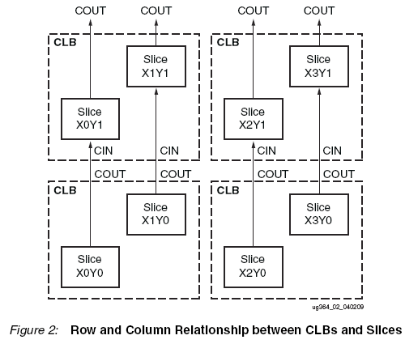
Xilinx L and M Slices Approach for configurable logic blocks (CLBs)
“Every slice contains four logic-function generators (or LUTs), eight storage elements, wide-function multiplexers, and carry logic. These elements are used by all slices to provide logic, arithmetic, and ROM functions. In addition to this, some slices support
two additional functions: storing data using distributed RAM and shifting data with 32-bit registers. Slices that support these additional functions are called SLICEM; others are called SLICEL. SLICEM represents a superset of elements and connections found in all slices. Each CLB can contain zero or one SLICEM. Every other CLB column contains a SLICEMs.
In addition, the two CLB columns to the left of the DSP48E columns both contain a SLICEL
and a SLICEM.”
Source: http://www.xilinx.com/support/documentation/user_guides/ug364.pdf pg 8

Slide 28
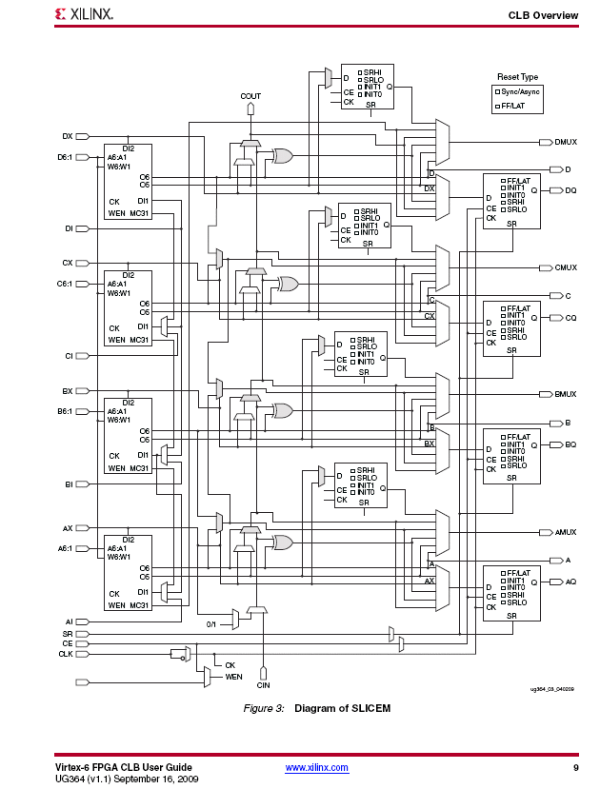
SLICEM slices support additional functions; they are a superset of SLICELs; i.e. the have all the standard LEs plus some additions.
Source: http://www.xilinx.com/support/documentation/user_guides/ug364.pdf pg 9

Slide 29
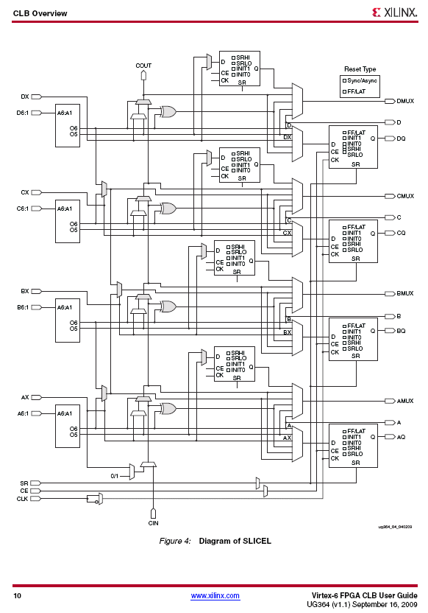
SLICEL slices contain the standard set of LEs for the particular FPGA concerned. As the diagram shows, it looks a little less complicated than the design of a SLICEM.
Source: http://www.xilinx.com/support/documentation/user_guides/ug364.pdf pg 10

Slide 30
HDL to FPGA execution & LE cost
In order to implement a HDL design, the design need to be decomposed and mapped to the physical LBs on the FPGA and the interconnects need to be appropriately configured.
Example:
x = AND(e,f,g)
y = AND(b,NAND(NAND(b,c),d))
out = NAND((NAND(x,y),NAND(a,y))
Map ‘AND(e,f,g)’ to LB1
Map ‘NAND((NAND(x,y),NAND(a,y))’ to LB2
x
out
y
Map ‘AND(b,NAND(NAND(b,c),d)) ’ to LB3
Costing: 3 LBs, 8 LEs (assuming LBs have LEs that are AND or NAND gates)

Slide 31
Timing calculations
The previous slide didn’t show whether the connections were synchronized (i.e., a shared clock) or asynchronous –since they are all logic gates and no clocks show it’s probably asynchronous
Determining the timing constrains for synchronous configurations are generally easier, because everything is related to the clock speed. Still, you need to keep in mind cascading calculations.
For asynchronous use, the implementation could run faster, but can also become a more complicated design, and be more difficult to work out the timing…

Slide 32
Async Timing calculations
Keep in mind that the propagation delays for the various gates / LUTs may be different – for example, in the previous example, let’s assume each AND may take 6ns to stabilise, and the NANDS 10ns.
So time to compute out is =
  MAX OF (time to compute x, time to compute y) + 2x10ns = (2x10ns+6ns) + 20ns = 46ns = pretty fast!! Or is it??
  Compared to a 1GHz CPU using just registers (and no mem access)?
  Try this calculation for yourself ...
  (assume each instruction takes on avg. 3 clocks due to pipeline,
  data dependencies, etc, as worst case performance on a
  RISC processor)

Slide 33
Comparing to CPU speed
CPU running at 1GHz → each clock 1ns period
Assume each instruction takes ~ 5 clocks each due to pipeline etc
CODE:
int doit ( unsigned a, b, c, d, e, f, g ) {
unsigned x = AND(e,f,g);
unsigned y = AND(b,NAND(NAND(b,c),d))
out = NAND((NAND(x,y),NAND(a,y))
return out;
}
But some of these
Can’t be done as just 1
RISC instruction.
unsigned t1 = AND(e,f); → 1 instruction, i.e. AND t1,e,f
unsigned x = AND(t1,g);
unsigned t1 = NAND(b,c)
unsigned t2 = NAND(t1,d)
unsigned y = AND(b,t2)
t1 = NAND(x,y)
t2 = NAND(a,y)
out = NAND(t1,t2)
in all 8 instructions → 8 x 3 clocks ea.
= 24 ns (assuming all registers pre-loaded)
A speed-up of 1.92 over the FPGA case

Slide 34
Plans for Next lecture
RC architecture case studies
  IBM Blade & the cell processor
  Some large-scale RC systems
Amdahl’s Law reviewed and critiqued

